Slide 1
Microbial Genetics
Dr Alex Owusu-Ofori

Slide 2
Lecture objectives
To understand the role of DNA in microorganisms
To establish the genetic basis of microbial functions
To appreciate some genetic mechanisms including transfer of DNA, mutation and gene rearrangement, genetic engineering and mutations

Slide 3
Microbial Genetics: Introduction
Microbial Genetics (MG) forms the basis of understanding most of the phenomena that causes problems in infectious diseases or that help us overcome infectious diseases. Development of antimicrobial resistance , disease re-emergence and the development of antimicrobials and vaccines.
MG is the study of inheritance and the variability of the characteristics of microorganisms
Inheritance concern the exact transmission of genetic information from parents to their progeny. Variability of the inheritance characteristics' can be accounted for either by a change in the genetic makeup of a cell or environmental conditions.

Slide 4
Terminologies in genetics
Phenotype
  The appearance or discernible characteristics of a trait in an individual
  Mutation in a gene responsible for a phenotype may cause a change in the phenotype.
  Typically, more that one gene is responsible for a phenotype.
Genotype
  The genetic makeup of an individual with reference to one or more specific genes

Slide 5
Terminologies in genetics
Chromosome: The large DNA molecule of a bacterial cell that contains all the information/plans for the cell.
Gene: a segment of DNA and its sequence of nucleotides that codes for a functional product, usually but not always a protein.
Base pair: In the double helix structure each rung of this twisted latter is made of 2 nucleotides either AT or GC, These complementary base pairs make the replication of DNA possible. Each strand serves as a template for the other strand.
Genetic code: the linear sequence of nucleotides that codes for specific RNA’s and proteins. For proteins each set of 3 nucleotides codes for a specific amino acid within the protein.

Slide 6
Nucleic acids
Nucleic Acids
  Composed of chains of nucleotides
  Nucleic acid molecules are usually composed of
  4 different nucleotides
  A nucleic acid molecule may contain several thousands or millions of nucleotides
  Each nucleic acid molecule has its own order, or “sequence,” of nucleotides
  The correct sequence of nucleotides is essential for the nucleic acid’s function

Slide 7
Nucleotide structure
  A nucleotide consists of:
    Nitrogenous base
    Pentose sugar
    Phosphate group
  Nitrogenous bases:
    Purines: adenine & guanine
    Pyrimidines: cytosine, thymine (in DNA), & uracil (in RNA)
  Pentose sugars:
    Ribose (found in RNA)
    Deoxyribose (found in DNA)

Slide 8
Deoxyribonucleic acid (DNA)
DNA
  Pentose sugar: 2’-deoxyribose
  Nitrogenous bases:
  Adenine and guanine (purines)
  Cytosine and thymine (pyrimidines)
  Structure is typically a double-stranded helix
  Nucleotide sequences of the strands are complementary to each other, A pairing with T and C pairing with G

Slide 9
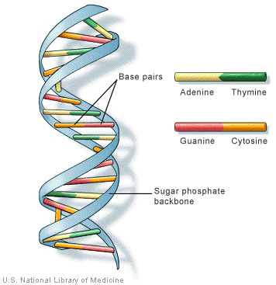

Slide 10
Ribonucleic acid (RNA)
RNA:
  Pentose sugar: Ribose
  Nitrogenous bases:
  Adenine and guanine (purines)
  Cytosine and uracil (pyrimidines)
  Structure is typically single-stranded; however, there may be internal complementary regions within an RNA strand that can form double-stranded “hairpin loops” (C to G; A to U)
  An RNA strand can also form a double-stranded structure with a DNA strand; in this case, the U on the RNA will base-pair with the A on the DNA.

Slide 11
Overall function
  The nucleotide sequence of a nucleic acid molecule encodes the amino acid sequence of a protein.
  Genome: The entire nucleotide sequence of an organism; transmitted to offspring during reproduction
  Deoxyribonucleic acid (DNA): DNA molecules serve as the genome for the proteins of all cellular organisms, both eukaryotic and prokaryotic. DNA also serves as the genome for certain viral groups.
  Ribonucleic acid (RNA): RNA molecules serve as an intermediate in gene expression in eukaryotic and prokaryotic organisms, as well as some viruses. RNA serves as the genome for certain viral groups.

Slide 12
Important Processes in Genetics
  DNA Replication: The sequence of a nucleotide in a DNA molecule serves as a template to copy itself, so two identical copies of the DNA helix are formed.
  Transcription: The sequence of nucleotides in a DNA molecule serves as a template for the synthesis of an RNA molecule; typically, only a small segment of the DNA is copied. This is the first step in gene expression.
  Translation: The sequence of nucleotides in an RNA molecule serves to direct the assembly of amino acids into a protein chain on a ribosome. This is the second step in gene expression.

Slide 13
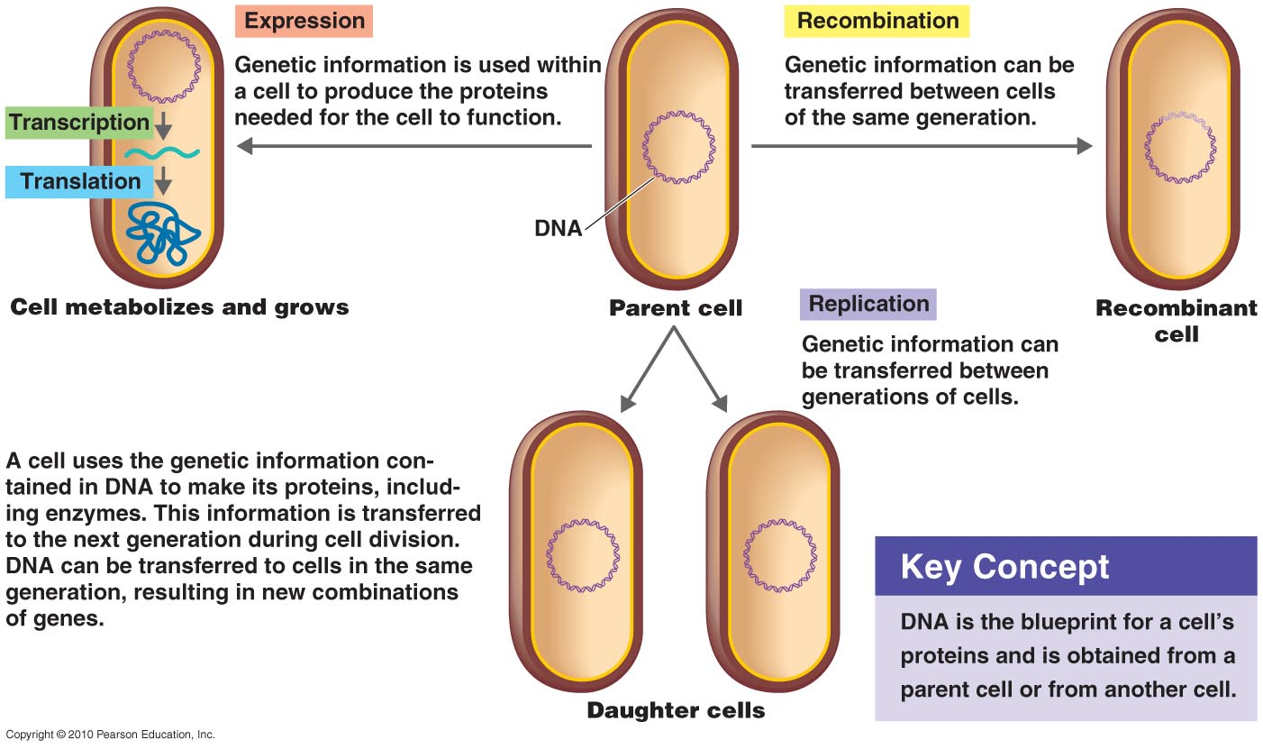
The Flow of Genetic Information
Notes:
13

Slide 14
DNA Replication
The double strand of DNA is separated.
DNA polymerase reads the DNA strand and creates another.
The newly synthesized DNA contains an old strand and a new strand.
The two new strands are then separated into the two new daughter cells.

Slide 15
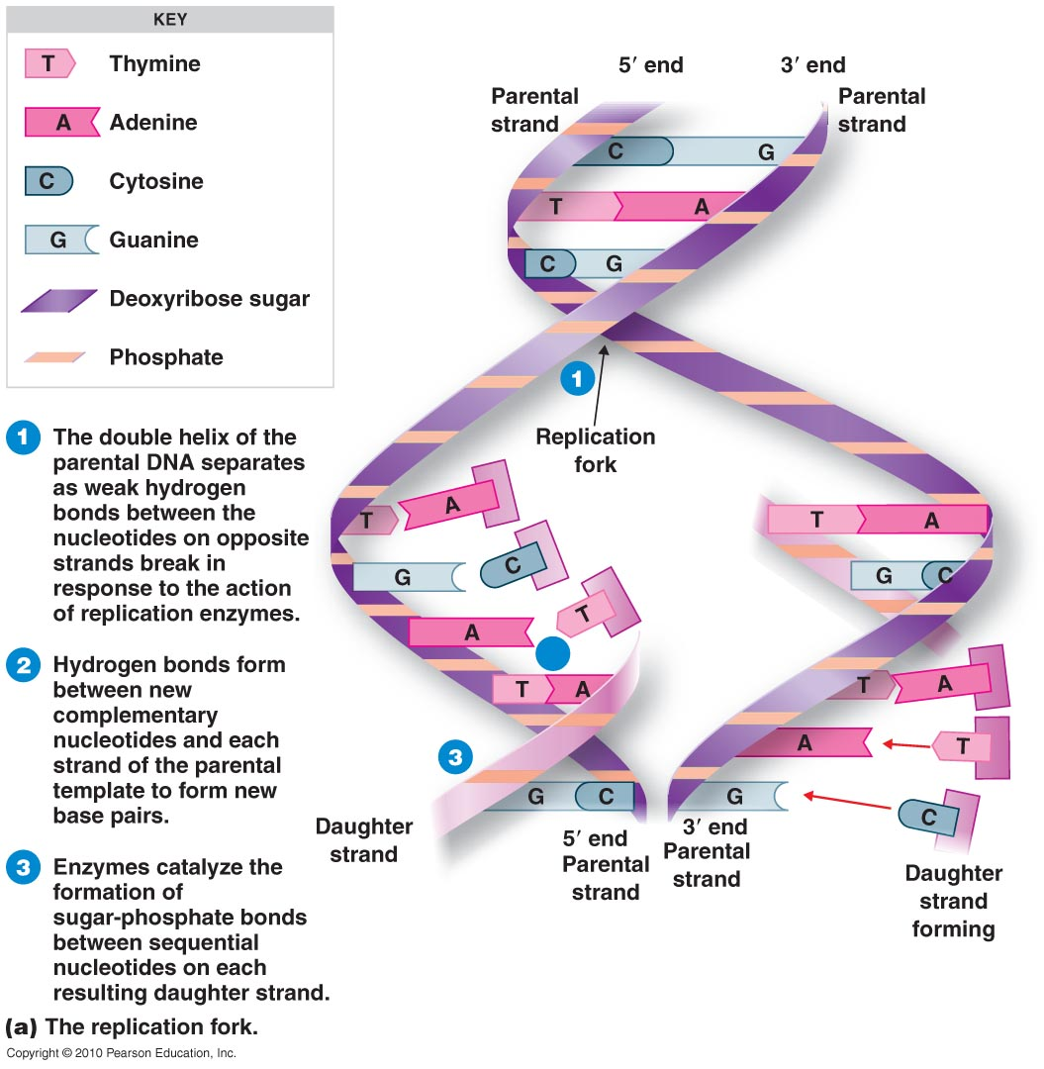
Semiconservative Replication
Notes:
15

Slide 16
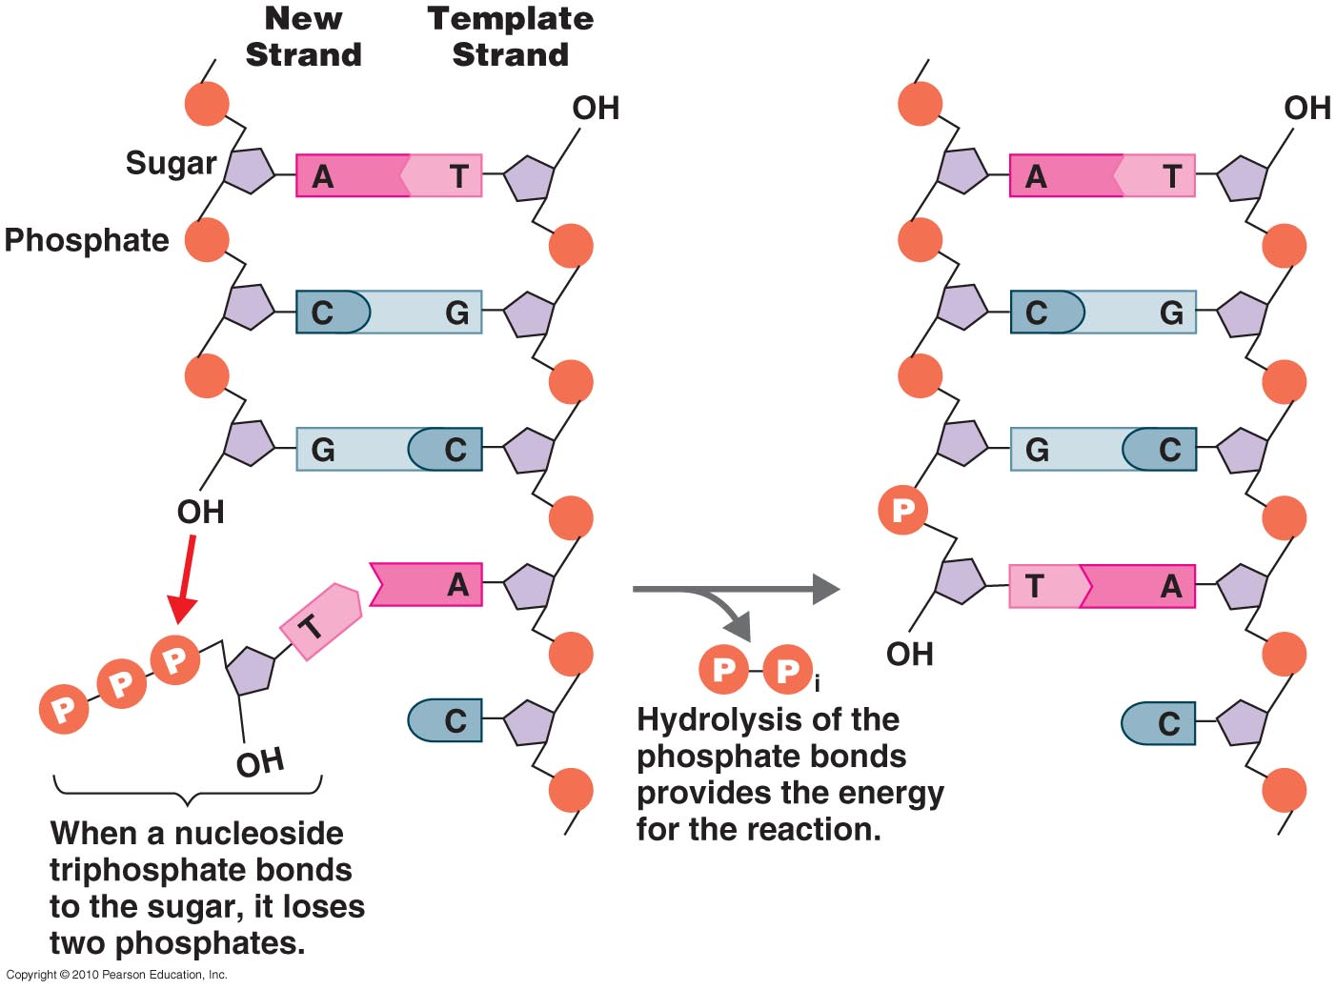
DNA Synthesis
Notes:
16

Slide 17
DNA Synthesis
DNA is copied by DNA polymerase
  In the 5' → 3' direction
  Initiated by an RNA primer
  Leading strand is synthesized continuously
  Lagging strand is synthesized discontinuously
  Okazaki fragments
  RNA primers are removed and Okazaki fragments joined by a DNA polymerase and DNA ligase
  Okazaki fragments are short, newly synthesized DNA fragments that are formed on the lagging template strand during DNA replication
Notes:
17

Slide 18
Transcription
Transcription is the synthesis of RNA
A sequence of DNA is relaxed and opened up.
RNA polymerase synthesizes a strand of RNA
RNA uses ACGU
Starting point is a promoter

Slide 19
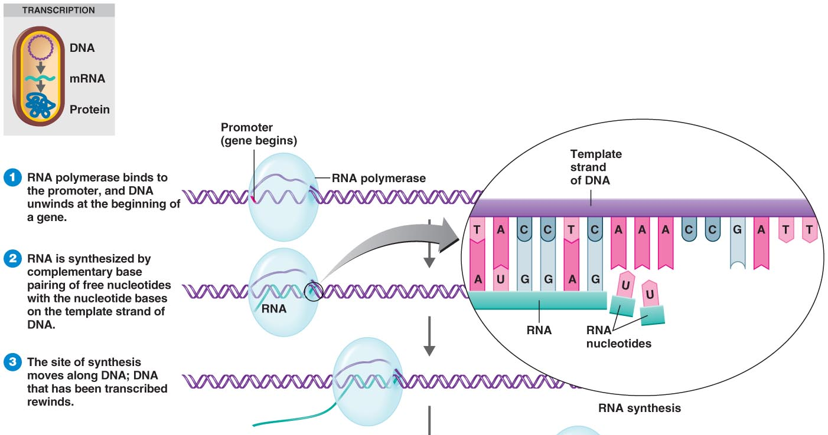
The Process of Transcription
Notes:
19

Slide 20
Translation
Translation is the name given to protein synthesis
mRNA associates with ribosome's (rRNA and protein)
3-base segments of mRNA specify amino acids and are called codons.
Genetic code: relationship among nucleotide sequence and corresponding DNA sequence.

Slide 21
Genes
  Contemporary understanding:
    A segment on a DNA molecule
    Usually at a specific location (locus) on a chromosome or plasmid
    Characterized by its nucleotide sequence
  Genes play three notable roles:
    To encode the nucleotide sequences of mRNA, which in turn encodes the amino acid sequences of proteins
    To encode the nucleotide sequences of tRNA or rRNA
    To regulate the expression of other genes
  Mutation:
    Change in the nucleotide sequence of a gene, usually resulting from an error during DNA replication

Slide 22
Gene Regulation
Some gene regulators are expressed only as needed
  Repressible vrs Inducible genes
  Up regulation and down regulation
  Catabolite repression-eg in E.coli, synthesis of galactosidase is under repression in the presence of glucose and lactose due to the effect catabolite repression caused by glucose
  Catabolite repression is a type of positive control of transcription, since a regulatory protein affects an increase (upregulation) in the rate of transcription of an operon.
Notes:
22

Slide 23
Genetic Recombination
The rearrangement of genes.
Crossing over is where genes are recombined within a chromosome.

Slide 24
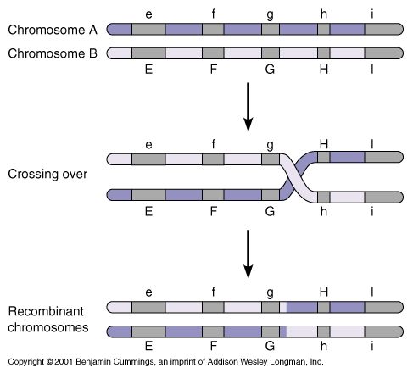

Slide 25
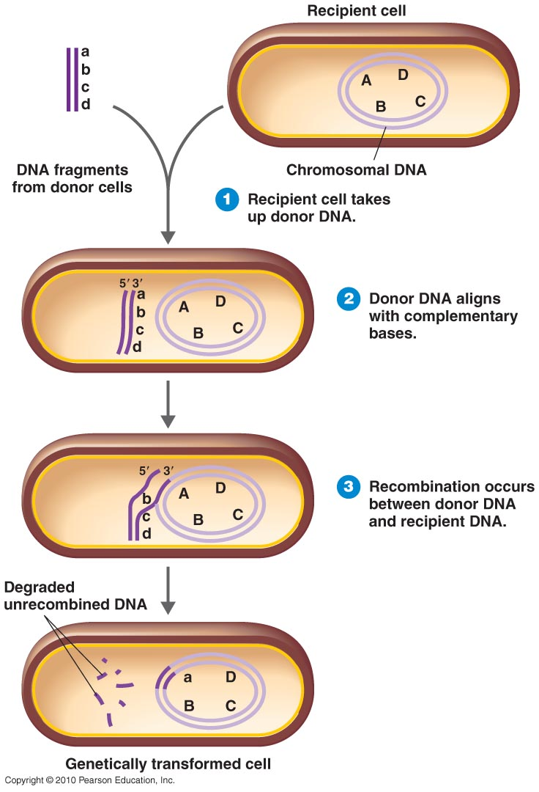
Genetic Recombination
Notes:
25

Slide 26
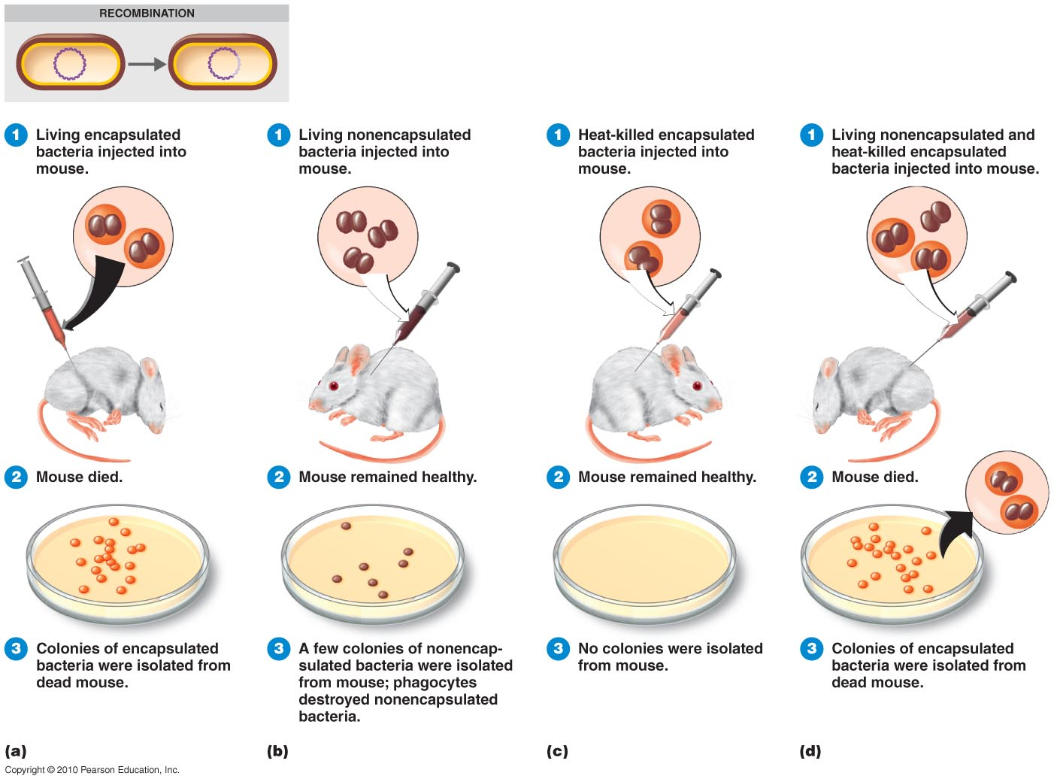
Genetic Transformation
Notes:
26

Slide 27
Mechanisms of Gene transfer
  There are three (3) broad mechanisms that mediate the efficient movement of DNA between cells.
  These are
  Conjugation where there is direct contact;
  Transduction, where DNA is introduced by way of an infecting bacteriophage
  Transformation where there is uptake of DNA that has been released into the cells enviroment

Slide 28
Conjugation
  A process of gene transfer from a living donor cell to a living recipient cell
  Typically, the donor cell will possess conjugative structures on its surface that attach the donor cell to the recipient cell. The conjugative structures will also mediate the transfer of DNA from the donor to the recipient.
  The ability to conjugate is often encoded on a plasmid.
  For example: In Escherichia coli, conjugation is mediated by the F pili that are encoded for by genes on the F plasmid.

Slide 29
Conjugation (cont.)
  A strain of E. coli having F plasmids and pili is called an F⁺ strain; a strain lacking F plasmids or pili is F–.
  When an F⁺ cell (the donor) is mated with an F– cell (the recipient), a copy the F plasmid is transferred to the F– cell, so that after the process is complete, both cells will be F⁺.
  In a cross of F⁺ x F–, only the plasmid is transferred. None of the chromosomal genes are transferred. Therefore, an F⁺ x F– does not give us any information about the position of genes on the bacterial chromosome.

Slide 30
Conjugation (cont.)
  In some strains of E. coli, an F plasmid DNA sequence has become inserted into the chromosome through genetic recombination. These are called Hfr strains. Different Hfr strains have the F sequence inserted at different locations on the chromosome.
  The cells of Hfr strains have F pili, and are capable of conjugating with F– cells. In an Hfr x F– mating, the F sequence is transferred first, followed by the chromosomal DNA.
  Genes from the Hfr (donor) chromosome can replace genes in the F– chromosome by genetic recombination.

Slide 31
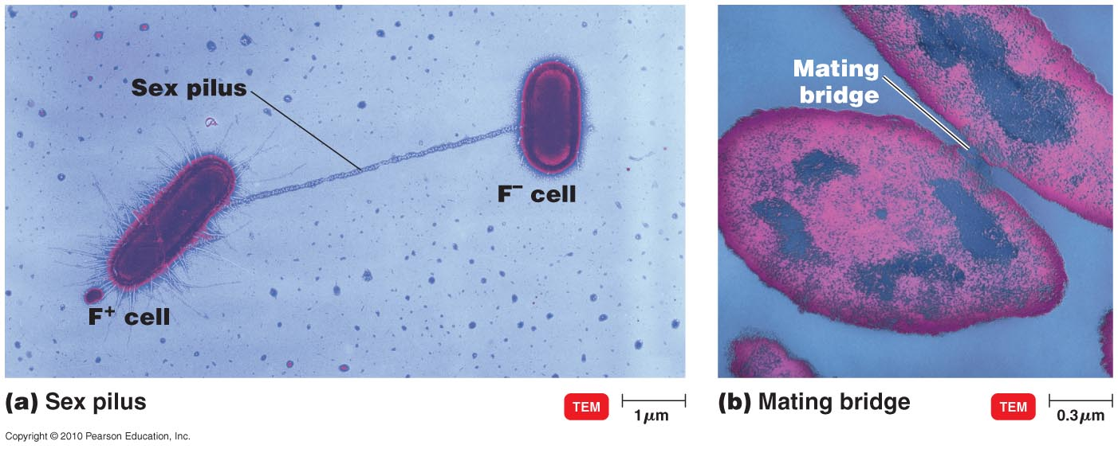
Bacterial Conjugation
Notes:
31

Slide 32
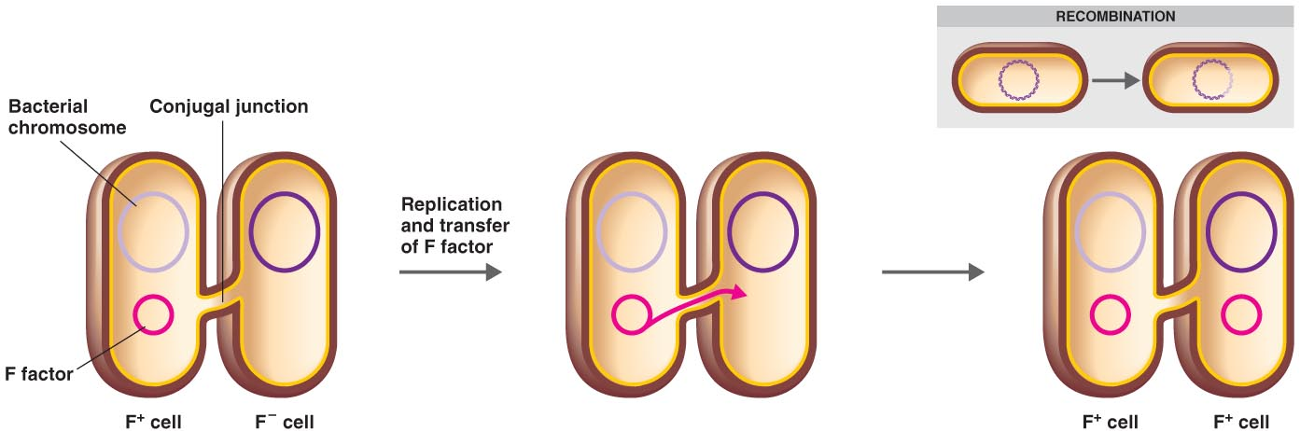
Conjugation in E. coli
Notes:
32

Slide 33
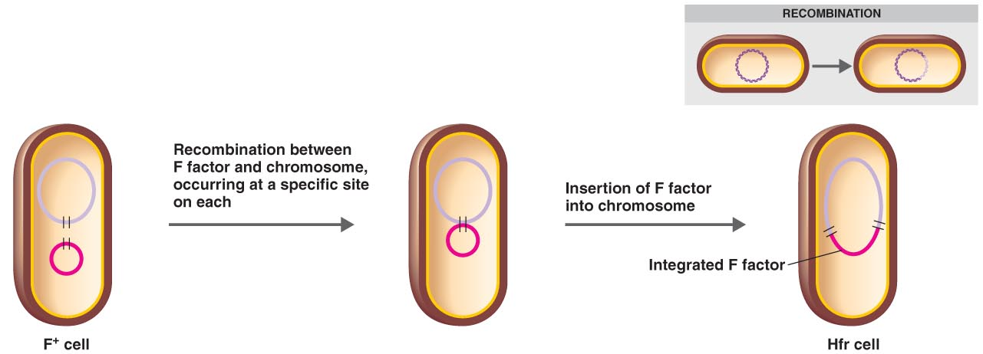
Conjugation in E. coli
Notes:
33

Slide 34
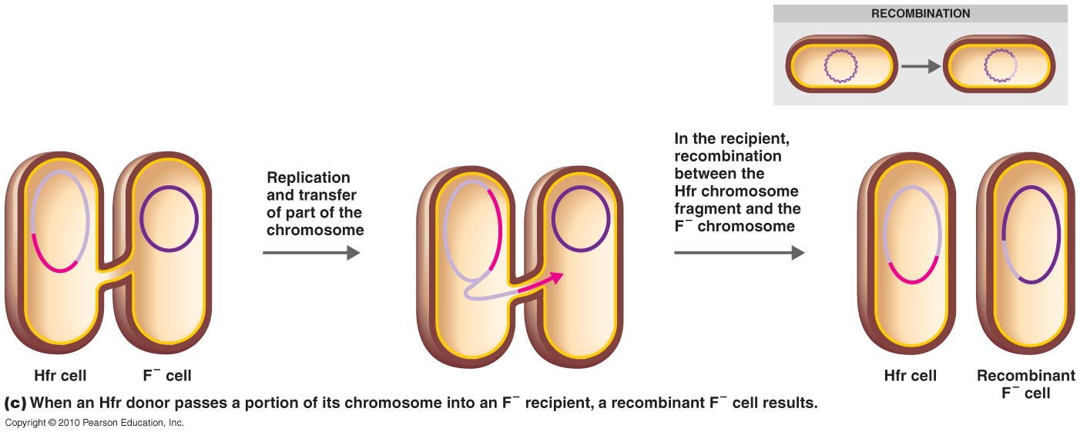
Conjugation in E. coli
Notes:
34

Slide 35
Transduction
  Transfer of genes from a donor cell to a recipient cell through a bacteriophage intermediate.
  Bacteriophage: A bacterial virus. They may have a lytic and lysogenic cycles or only lytic cycle.
  Virulent bacteriophage:
    Has only a lytic stage in its developmental cycle
    The lytic cycle results in the destruction of the infected cell and its membrane.
    When a virulent bacteriophage infects its host bacterium, it does not integrate its DNA into the host chromsome. Instead, it replicates its own DNA and capsid protein within the infected host, reassembles thousands of new virus particles, and lyses the host cell to release the new viruses.
    Example: T4 phage of E. coli

Slide 36
A lysogen or lysogenic bacterium is a bacterial cell in which a phage exists as DNA in its dormant state (prophage). A prophage is either integrated into the host bacteria's chromosome or more rarely exists as a stable plasmid within the host cell.

Slide 37
Transduction
  Temperate bacteriophage:
    A bacteriophage that has both lytic and lysogenic stages in its replication cycle
    In the lysogenic stage, the DNA of a temperate phage is inserted into a specific region of the host chromosome, where it is replicated every time the bacterial cell replicates
    During adverse growth conditions, the phage DNA comes out of the chromosome and begins a lytic stage, similar to that of a virulent phage. The virus replicates its DNA and protein, thousands of new virus particles are assembled, and the cell lyses to release the viruses.
    Example: lambda (λ) phage of E. coli

Slide 38
Transduction
  Random Generalized Transduction
    In this process, any of the genes from the donor chromosome may be transferred to the recipient.
    Random generalized transduction can be mediated by either virulent phages or certain temperate phages during their lytic stage. The virus must break down the host chromosome into fragments as part of its replication.
    When the host chromosome is broken into fragments, a small number of host chromosome fragments become packaged into viral capsids. These are the transducing particles of random generalized transduction. Since the host chromosome has been randomly broken into fragments, any of the host genes can randomly packaged into the transducing particles.

Slide 39
Transduction
  Specialized transduction
    This process can only be mediated by temperate phages.
    The only genes that can be transferred from the donor to the recipient are the genes that are immediately adjacent to the phage insertion site on the donor chromosome.
    When the phage DNA is excised from the chromosome as the virus enters its lytic cycle, occasionally there is a mistake and some of the chromosomal DNA becomes packaged into the phage capsid along with the viral DNA. These are the transducing particles of specialized transduction. The host chromosome is not broken up; instead, only the genes that are adjacent (next to) the phage insertion site can be packaged into the transducing particles.

Slide 40
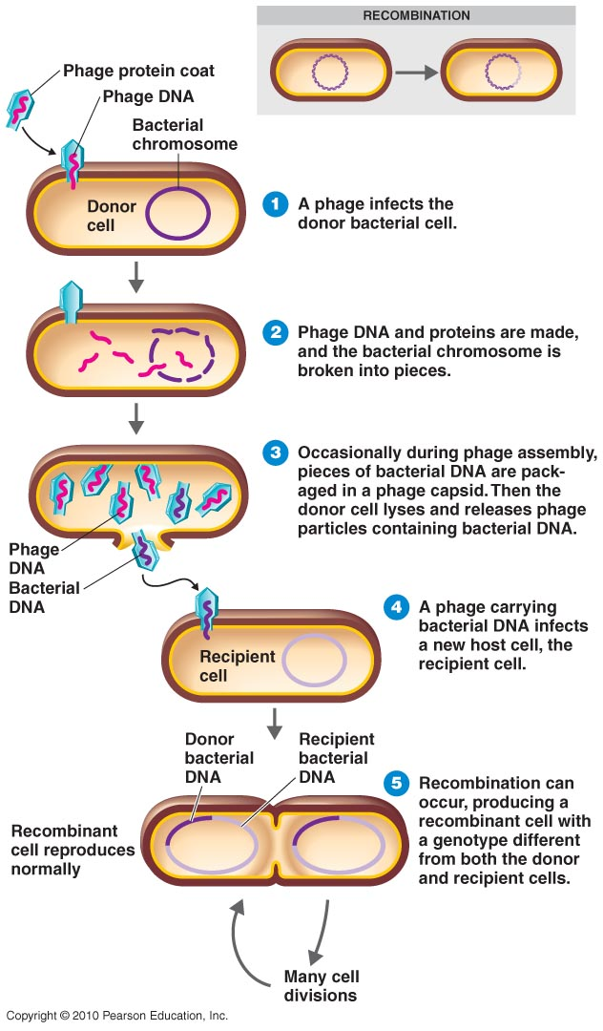
Transduction by a Bacteriophage
Notes:
40

Slide 41
Transformation
  Transfer of isolated donor DNA (either chromosomal DNA fragments or plasmid DNA) to a recipient cell.
  Successful transformation depends on the presence of double-stranded donor DNA molecules that are large enough, as well as cells that are competent for transformation

Slide 42
Transformation
  Competence
    Competence is the ability of a bacterial species or strain to take up DNA from its environment.
    Many species are naturally competent, such as Streptococcus pneumioniae, Acinetobacter calcoaceticus, Neiserria gonorrheae, and Bacillus subtilis
    Naturally competent species possess a nucleic acid transporter that spans their cell wall & plasma membrane.
      The transporter binds to double-stranded DNA, hydrolyzes one of the strands, and pulls the other strand into the recipient cell.
      The donor DNA strand may then recombine with the recipient chromosome, possibly changing the phenotype of the recipient to the donor phenotype.

Slide 43
Transformation
  Competence
    Competence can be induced in some species that are not naturally competent
      In certain noncompetent gram-negative species (for example, Escherichia coli), competence can be induced by treating the cells with divalent calcium ions (Ca²⁺), usually as a solution of calcium chloride.
      In certain noncompetent gram-positive species (for example, Geobacillus stearothermophilus), competence can be induced by removing the cell wall from the cells by lysozyme digestion.

Slide 44
Transformation
  Transformation is also a major technique used to introduce recombinant DNA molecules into host cells. In this case, the DNA is usually recombinant plasmids.

Slide 45
Mutations
Definitions
  Lethal mutation: results in death of the cell, and therefore cannot be propagated or studied
  Conditional mutation: One that is expressed only under certain environmental conditions; for example, a temperature-sensitive mutation
  Biochemical mutations: result in change in a biochemical pathway of the cell; for example, an auxotrophic mutation
  Spontaneous mutation: one that arises spontaneously due to error during DNA replication
  Induced mutation: one that has been caused by damage resulting from chemical or radiation treatment (mutagen)

Slide 46
Mutations
Mutations are the heritable changes in the structure of genes or changes in the DNA sequence.
Spontaneous mutations occurs at different frequencies in different populations or species of organisms
Wild –type alleles are the normal, usually active forms of a gene
Mutant alleles are the mutated, inactive form of the gene.

Slide 47
Types of mutations
Mutations can be in the form of base substitutions, deletions, insertions and rearrangements
Replacements: involves the substitution of one base for another
Deletions involve the removal of several base pairs
Microdeletions involve the removal of a single nucleotide
Insertions involve the addition of many base pairs of nucleotides at a single site
Microinsertion involves the addition of a single nucleotide

Slide 48
Types of mutations
Duplications are mutations that produce a redundant segment of DNA adjacent to the original. (THIS MAY BE REFERED TO AS TANDEM REPEATS).
eg. C-T-A-A-G-C-T-A-A-G-C-T-A-A-G
Tandem repeats are useful in resolving disputes in parenthood eg used in certain genealogical DNA tests(line of descent traced fron an ancestor).
Inversions are mutations that change the direction of a segment by splicing each strand of the segment into the complimentary strand

Slide 49
Mutations
Mechanisms of Induced Mutation
  Base analogs
    A chemical similar in structure to one of the bases and can substitute for it but doesn’t base pair normally
    For example, 5-bromouracil substitutes for thymine, but it frequently pairs with a G instead of A
  Specific Mispairing
    When a mutagen changes a base’s structure and thereby alters its base pairing
    For example: nitrosoguanidine adds a methyl group to guanine, causing it to pair with T instead of C.

Slide 50
Mutations
Mechanisms of Induced Mutation (cont.)
  Intercalating agents
    Examples include acridine orange and ethidium bromide
    Flat, planar, aromatic molecules that can fit between the stacked bases (intercalate) in the center of a DNA double helix and distort its geometry
    The distortion somehow induces single nucleotide insertions or deletions

Slide 51
Mutations
Mechanisms of Induced Mutation (cont.)
  Bypass of replication
    Chemical change or damage to bases is so severe that the bases can no longer base pair at all, and cannot serve as a template
    Example: formation of thymine dimers by UV irradiation; these cannot hydrogen bond at all
    Normally this would be lethal, but there are repair mechanisms that can bypass the damaged template, although many of these repair mechanisms are error-prone so generate a high frequency of mutations
    Mutations can lead to auxotrophy (inability of an organism to synthesize a particular organic compound required for growth)

Slide 52
Mutations
Auxotrophy is the inability of an organism to synthesize a particular organic compound required for growth.
Screening for Auxotrophs by Replica Plating
  A prototrophic (able to synthesize compounds required for growth) strain of bacteria is treated with a mutagenic agent (for example, nitrosoguanidine, or ultraviolet radiation).
  Most of the cells in the culture will die. However, a few may survive the mutagenesis. There is a high frequency of mutants among the survivors, some of which may be auxotrophic mutants.
  A sample of the culture is spread on a complete medium (for example, tryptic soy agar). This is the “master plate.”
  The master plate is incubated so the survivors can form colonies.

Slide 53
Mutations
Screening for Auxotrophs (cont.)
  Each colony from the master plate is transferred to a minimal medium plate (capable of only supporting the growth of prototrophic colonies) and a complete medium plate (capable of supporting both prototrophic and auxotrophic colonies).
  Colonies that grow on the complete medium but not on the minimal medium are auxotrophs. They are isolated onto fresh complete medium, and the cause of their auxotrophy (what supplement they need for growth) is determined.

Slide 54
Mutations
Ames test
  Used to test chemicals for potential carcinogenic properties
  Based on the idea that most carcinogens are also mutagenic
  Utilizes histidine auxotrophic (a mutant strain that requires a particular nutrient that a normal strain does not)strains of Salmonella typhimurum
  Cells are plated in medium with limited histidine, duplicate plates with and without the test mutagen.
  The number of histidine prototrophic revertants with and without the test mutagen are counted to determine the relative mutagenicity of the agent

Slide 55
Mutations
Ames test (cont)
  Mammalian liver extract may be added to the medium, because some substances may become mutagenic only after being metabolized by the liver.
  Not all carcinogens are detected by the Ames test; other tests modeled on the Ames strategy have employed either yeast cells, cultured mammalian cells, or even live mice injected with the test mutagen

Slide 56
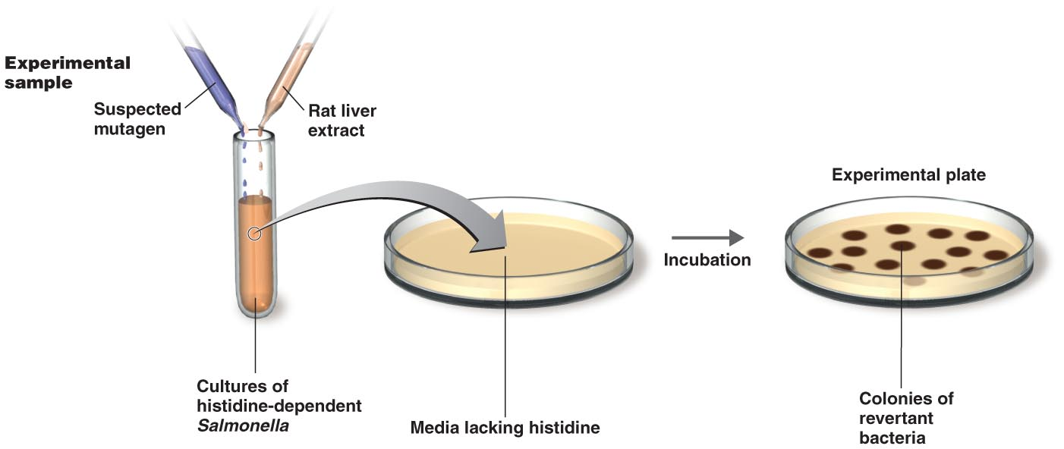
Ames Test for Chemical Carcinogens
Notes:
56

Slide 57
Effects of mutations
Missense mutation: replacement mutation in a codon changing the mRNA transcript to a different amino acid eg. AAG (lysine) to GAG (glutamine).
Nonsense mutation: replacement mutation changes a codon specifying an amino acid to one specifying none eg. UAC (tyrosine) to a UAA (stop).
Silent mutation: this mutation codes for a similar amino acid

Slide 58
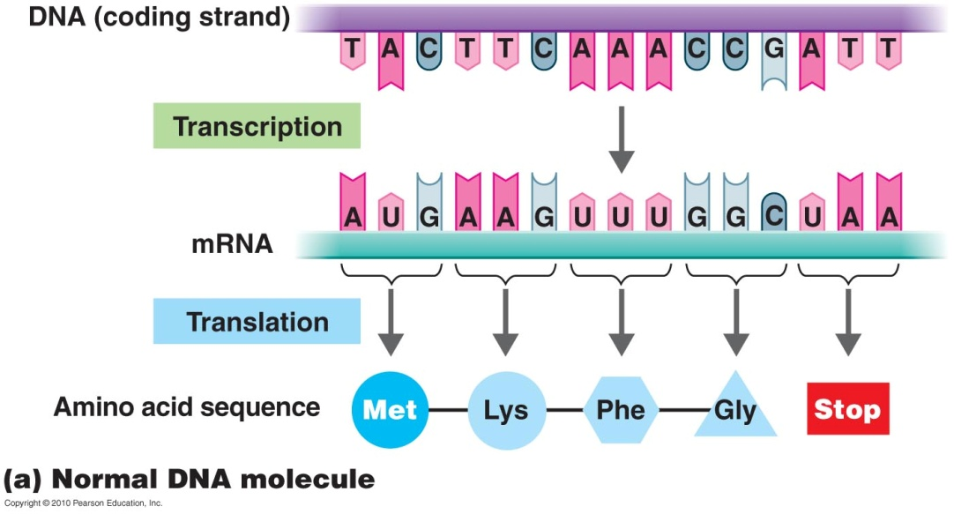
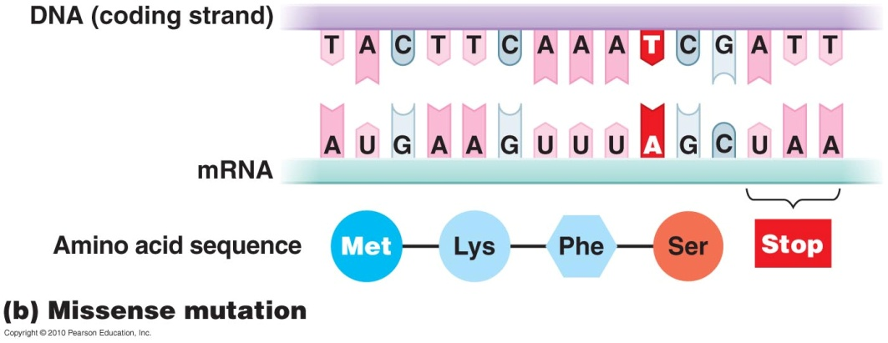
Mutation
Base substitution (point mutation)
Missense mutation
Change in one base
Result in change in amino acid
Notes:
58

Slide 59

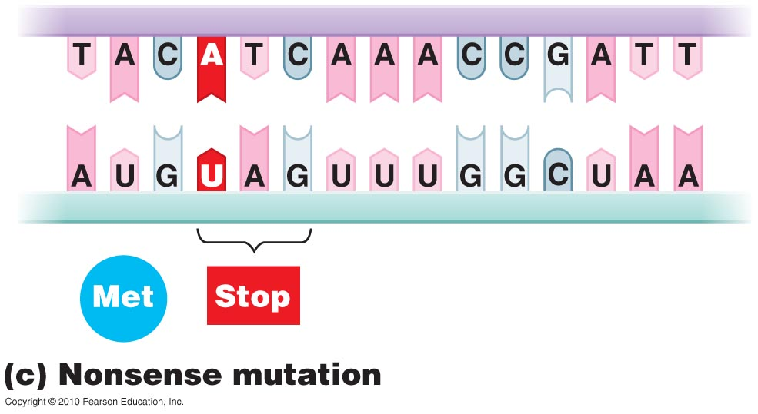
Mutation
Nonsense mutation
Results in a nonsense codon
Notes:
59

Slide 60
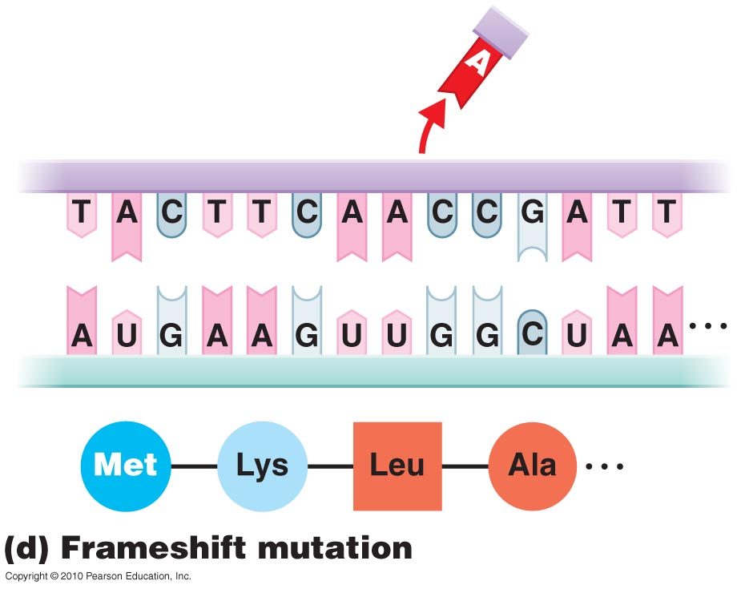
Mutation
Frameshift mutation
Insertion or deletion of one or more nucleotide pairs
Notes:
60

Slide 61
Applications
PCR based methods for diagnoses.
Recombinant DNA eg recently developed HPV vaccine. Hepatitis B vaccine was the first recombinant vaccine.
Genetically modified food
Recombinant proteins using genetic engineering to produce insulin, factor VIII for haemophilia

